Slide 1
Unit 4
18AIC207J – DBMS FOR AI

Slide 2
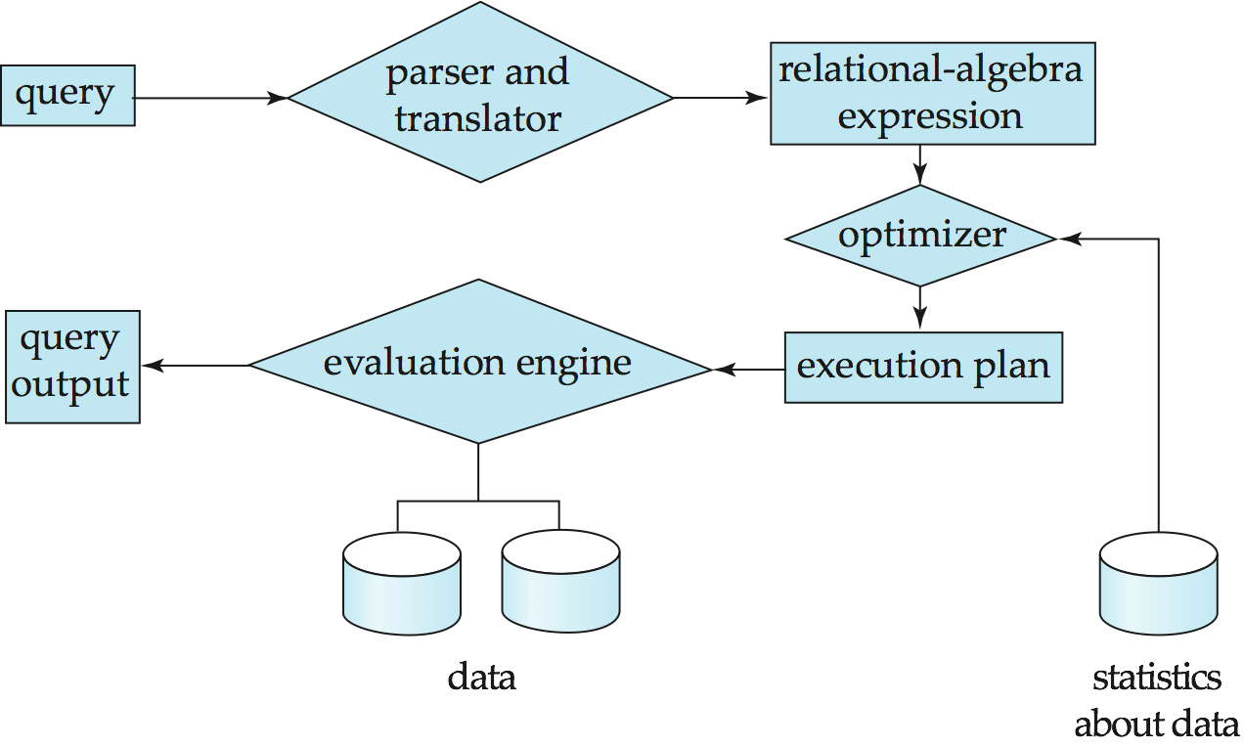
Query Processing
1. Parsing and translation
2. Optimization
3. Evaluation
Notes:
‹#›

Slide 3
Query Processing (Cont.)
Alternative ways of evaluating a given query
Equivalent expressions
Different algorithms for each operation
Cost difference between a good and a bad way of evaluating a query can be enormous
Need to estimate the cost of operations
Depends critically on statistical information about relations which the database must maintain
Need to estimate statistics for intermediate results to compute cost of complex expressions
Notes:
‹#›

Slide 4
Transaction Management
What if the system fails?
What if more than one user is concurrently updating the same data?
A transaction is a collection of operations that performs a single logical function in a database application
Transaction-management component ensures that the database remains in a consistent (correct) state despite system failures (e.g., power failures and operating system crashes) and transaction failures.
Concurrency-control manager controls the interaction among the concurrent transactions, to ensure the consistency of the database.
Notes:
‹#›

Slide 5
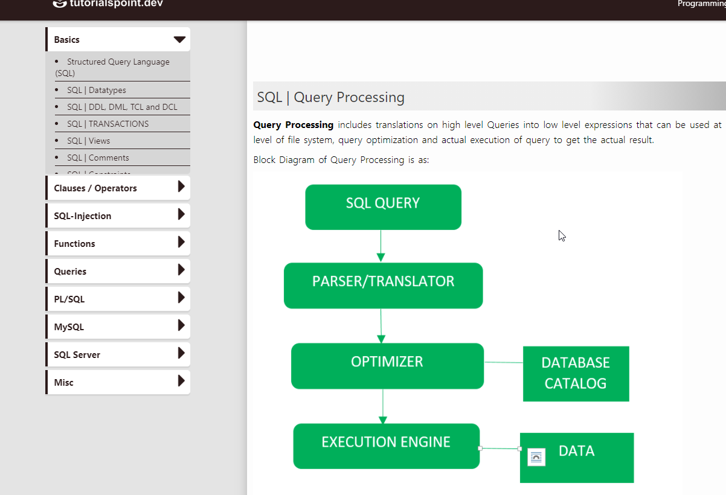
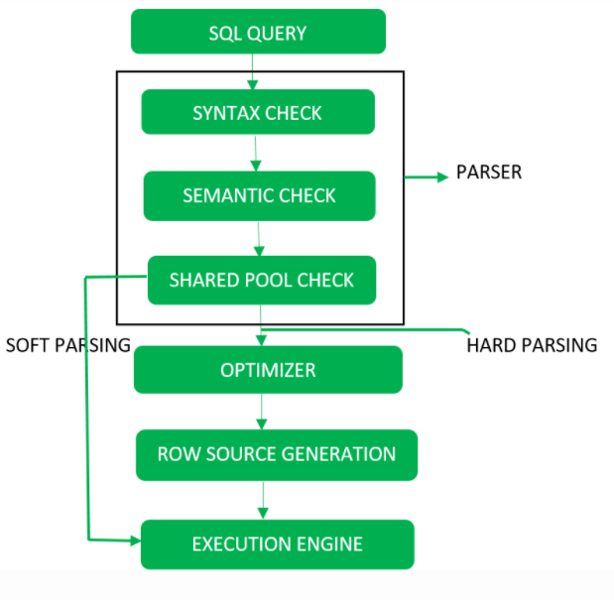
Query Processing
Query Processing includes translations on high level Queries into low level expressions that can be used at physical level of file system, query optimization and actual execution of query to get the actual result.
Block Diagram of Query Processing Detailed DiagramQuery Processing

Slide 6
Step-1
Parser: During parse call, the database performs the following checks- Syntax check, Semantic check and Shared pool check, after converting the query into relational algebra.
Parser performs the following
Syntax check – concludes SQL syntactic validity.
SELECT * FROM employee;
Semantic check – determines whether the statement is meaningful or not. Example: query contains a tablename which does not exist is checked by this check.
Shared Pool check – Every query possess a hash code during its execution. So, this check determines existence of written hash code in shared pool if code exists in shared pool then database will not take additional steps for optimization and execution.

Slide 7
Hard Parse and Soft Parse
If there is a fresh query and its hash code does not exist in shared pool then that query has to pass through from the additional steps known as hard parsing
If hash code exists then query does not passes through additional steps. It just passes directly to execution engine. This is known as soft parsing.
Step-2 Optimizer
During optimization stage, database must perform a hard parse at least for one unique DML statement and perform optimization during this parse. This database never optimizes DDL unless it includes a DML component such as subquery that require optimization.
It is a process in which multiple query execution plan for satisfying a query are examined and most efficient query plan is satisfied for execution.
Database catalog stores the execution plans and then optimizer passes the lowest cost plan for execution.

Slide 8
Row Source Generation
The Row Source Generation is a software that receives a optimal execution plan from the optimizer and produces an iterative execution plan that is usable by the rest of the database.
The iterative plan is the binary program that when executes by the sql engine produces the result set.
Step-3 Execution Engine
Finally runs the query and display the required result.

Slide 9
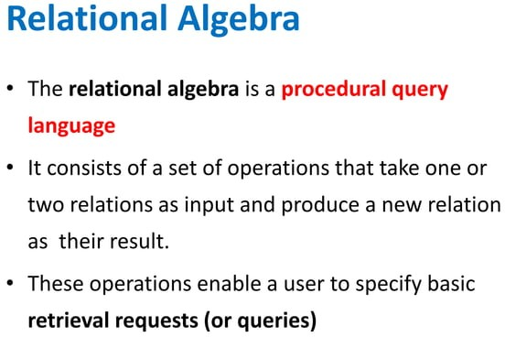

Slide 10
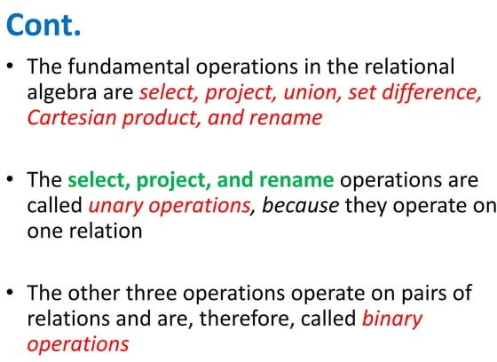

Slide 11
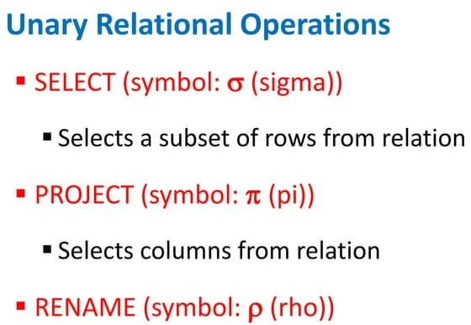

Slide 12
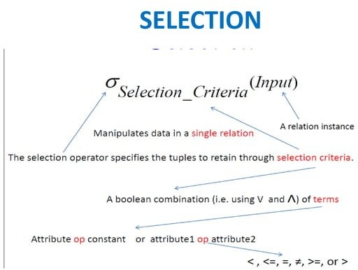

Slide 13
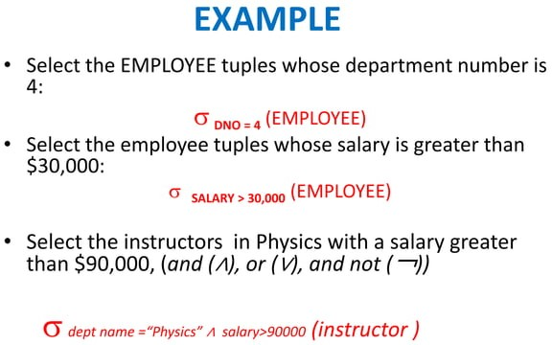

Slide 14
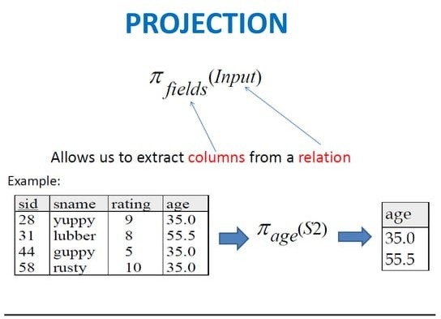

Slide 15
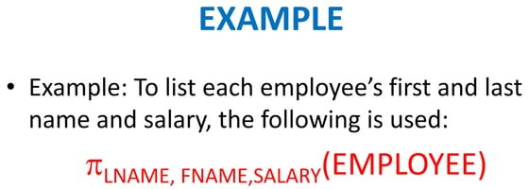

Slide 16
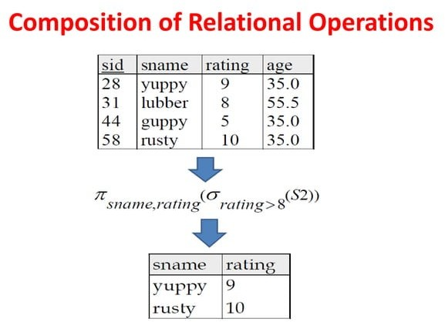

Slide 17
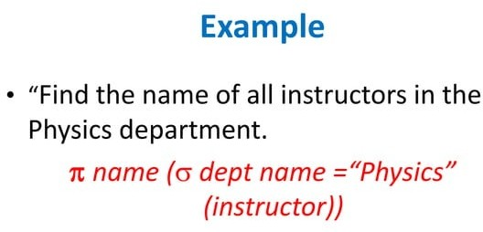

Slide 18
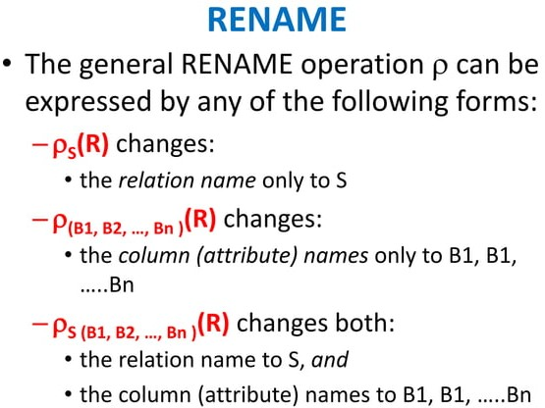

Slide 19
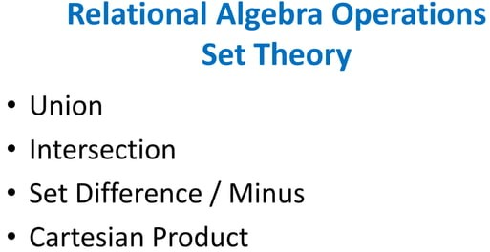

Slide 20
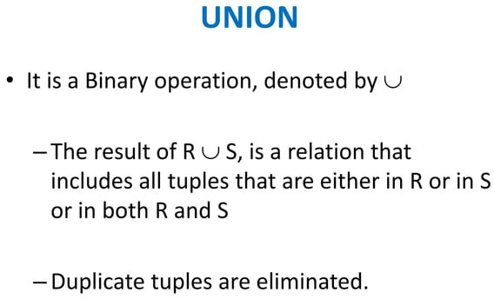

Slide 21
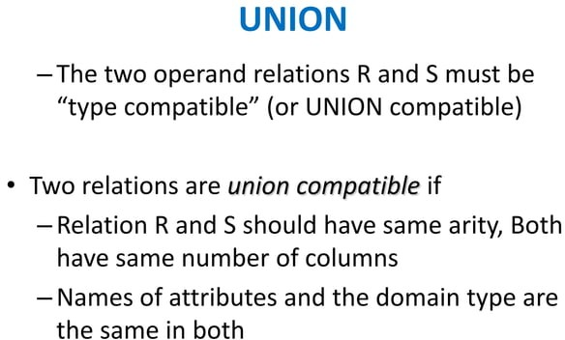

Slide 22
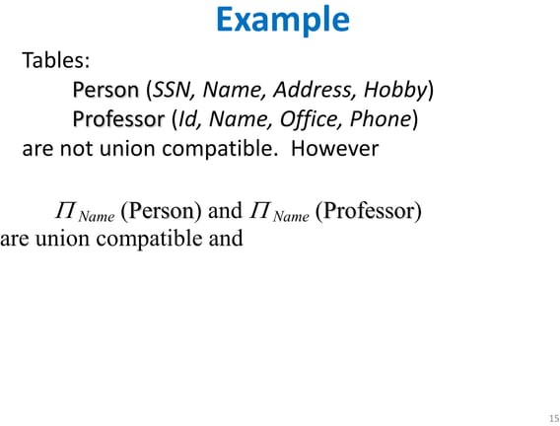

Slide 23
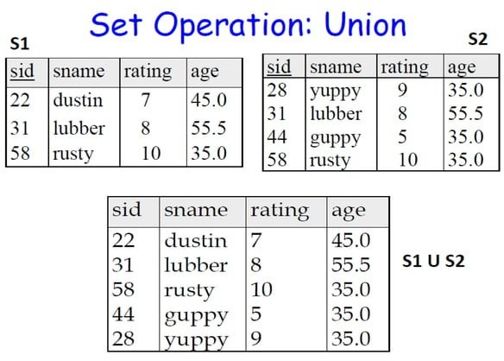

Slide 24
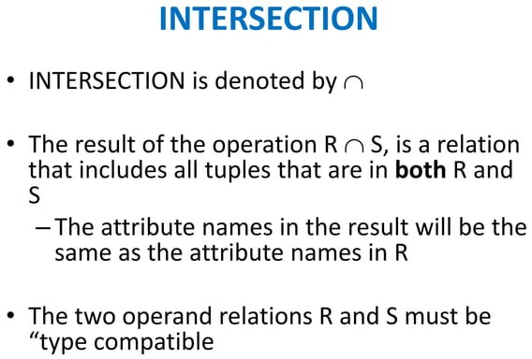

Slide 25
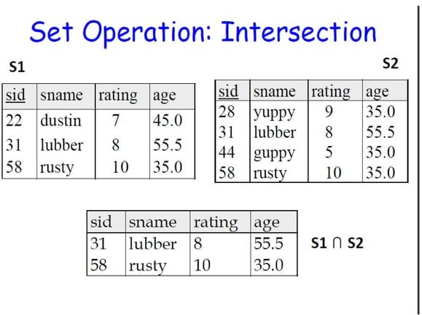

Slide 26
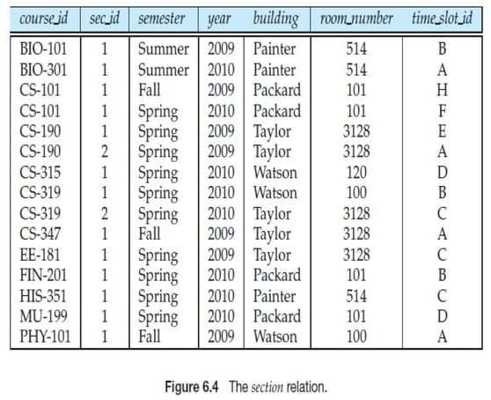

Slide 27
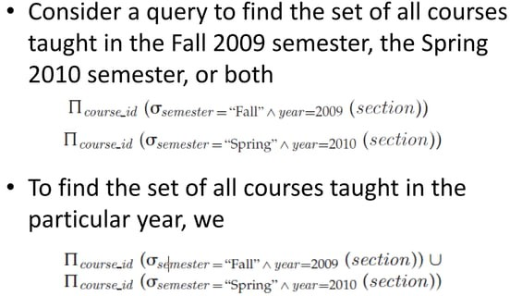

Slide 28
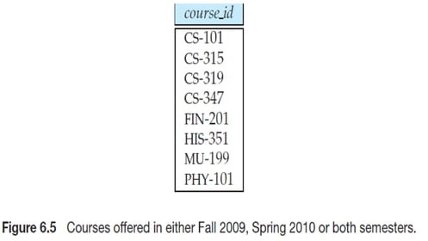

Slide 29
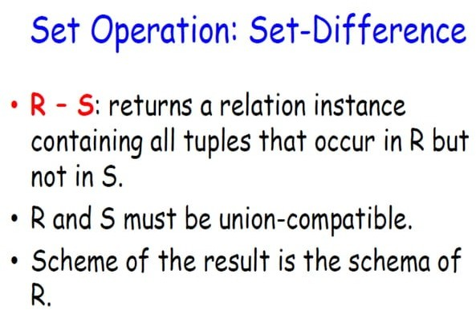

Slide 30
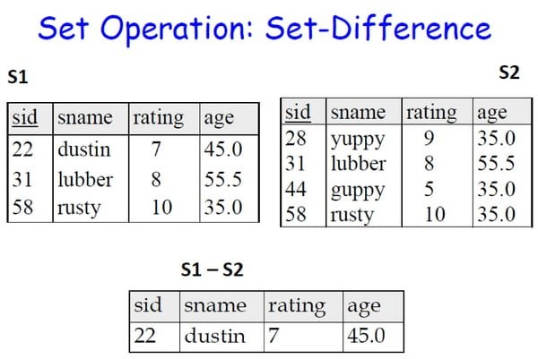

Slide 31
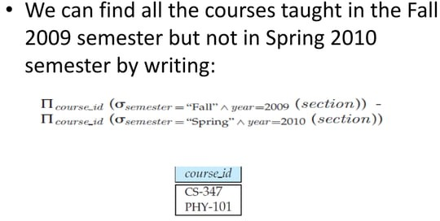

Slide 32
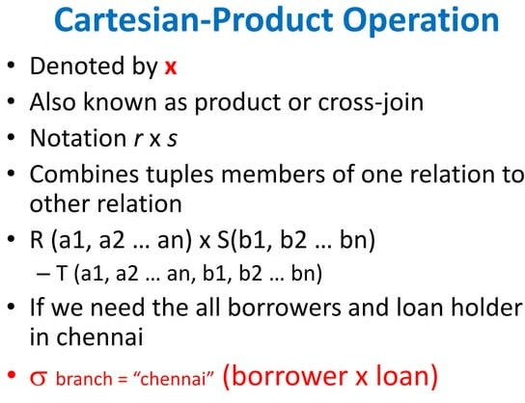

Slide 33
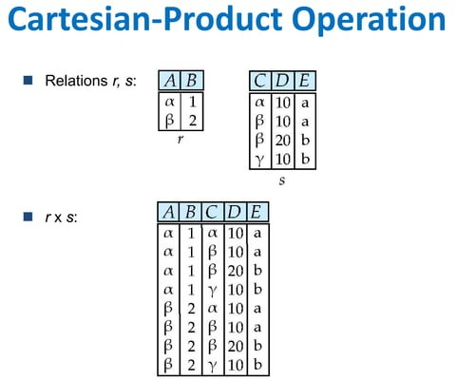

Slide 34
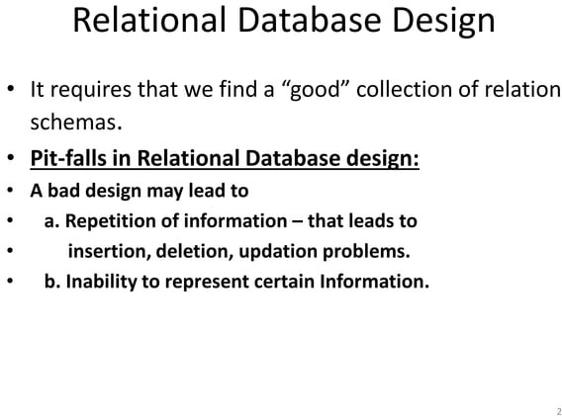

Slide 35
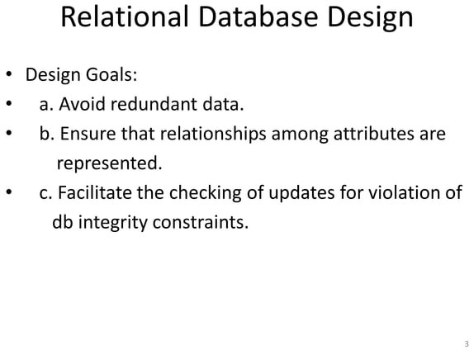

Slide 36
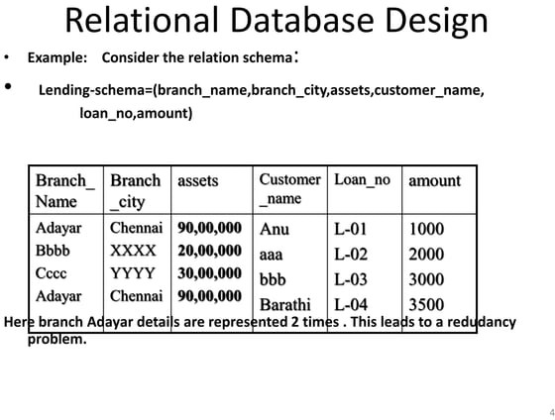

Slide 37
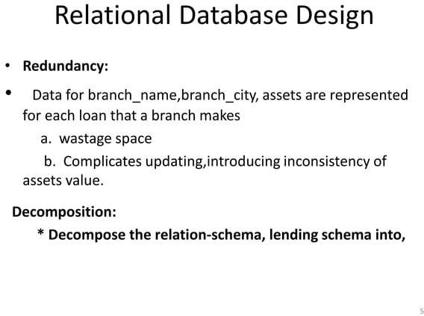

Slide 38
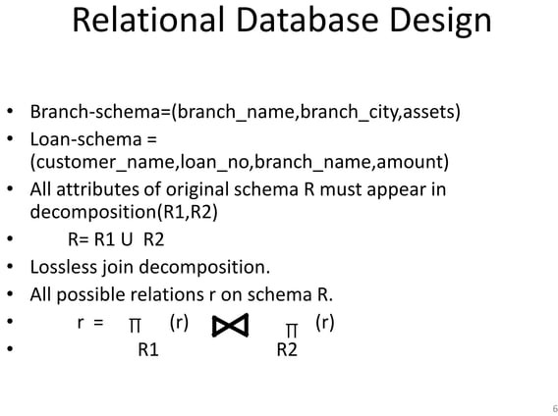

Slide 39
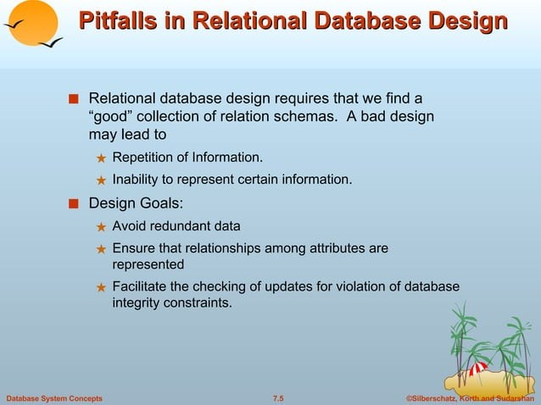

Slide 40
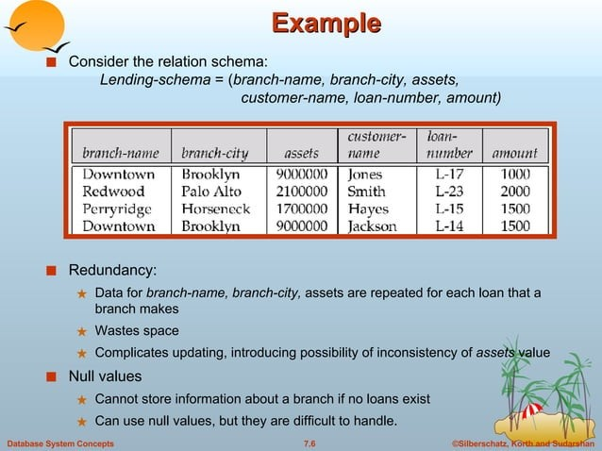

Slide 41
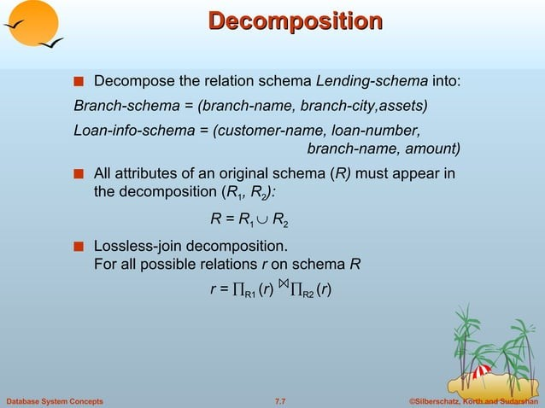

Slide 42
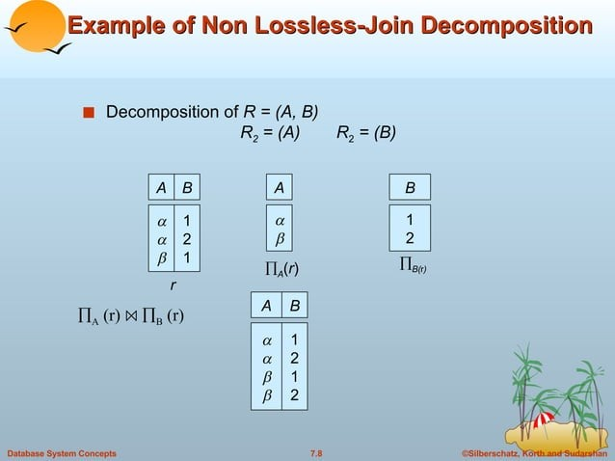

Slide 43
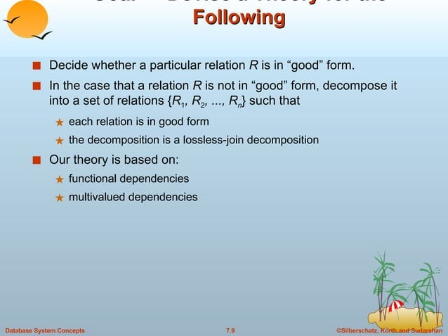

Slide 44
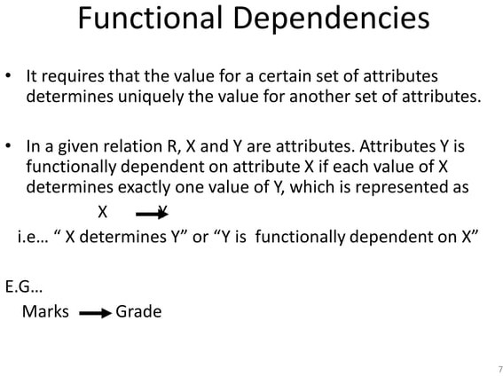

Slide 45
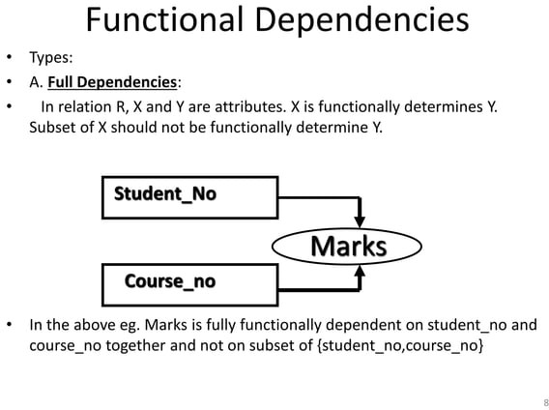

Slide 46
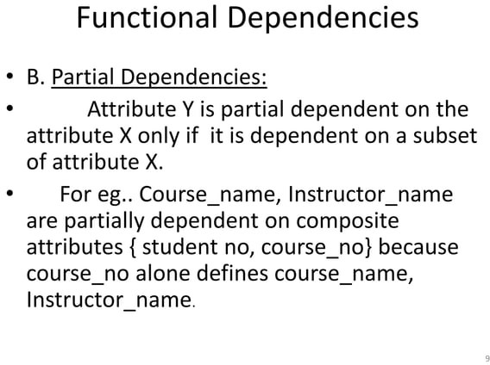

Slide 47
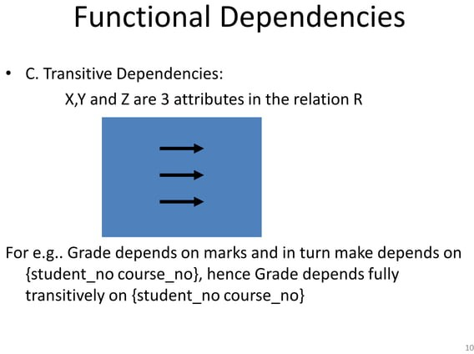

Slide 48
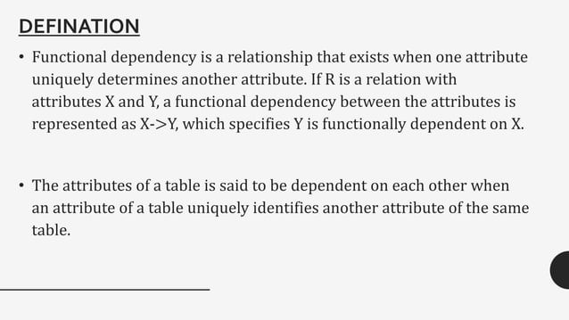

Slide 49
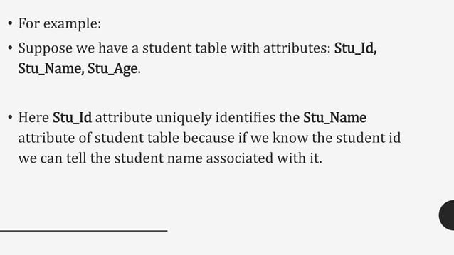

Slide 50
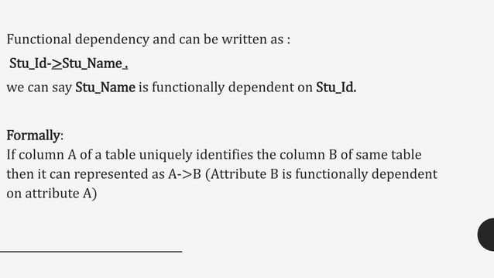

Slide 51
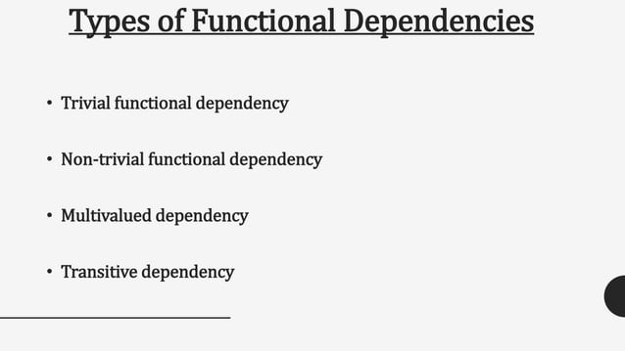

Slide 52
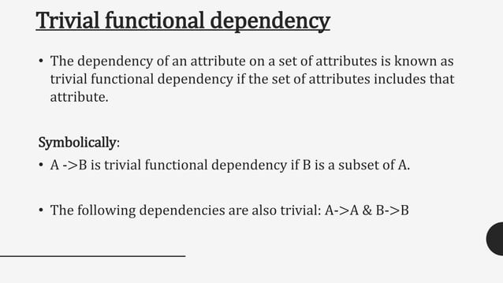

Slide 53
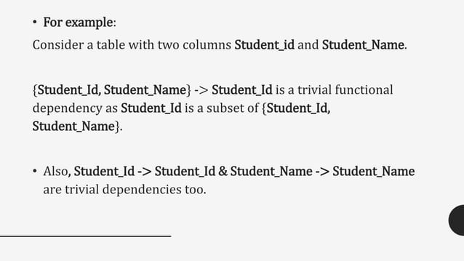

Slide 54
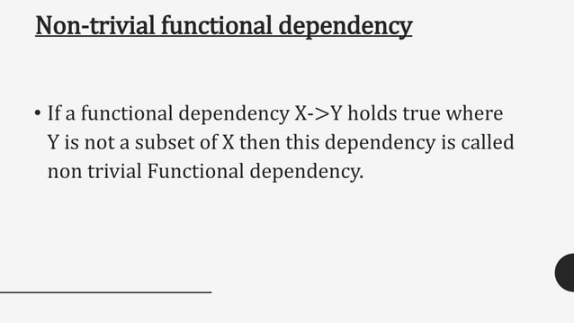

Slide 55
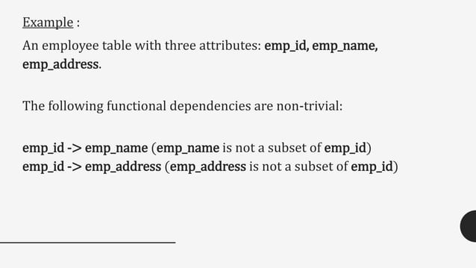

Slide 56


Slide 57


Slide 58


Slide 59


Slide 60


Slide 61


Slide 62


Slide 63


Slide 64


Slide 65


Slide 66


Slide 67


Slide 68


Slide 69


Slide 70


Slide 71


Slide 72


Slide 73


Slide 74


Slide 75


Slide 76


Slide 77


Slide 78


Slide 79


Slide 80


Slide 81


